Slide 1
Module 21

Slide 2
Let us see some examples to understand how hormones helps in coordinated growth

Slide 3
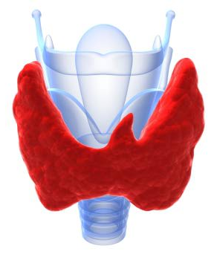
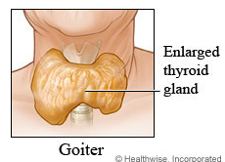
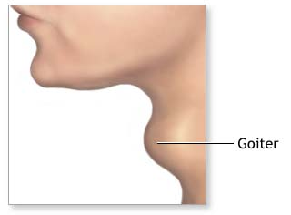
Which regulates
Carbohydrate, protein and fat metabolism in the body
Secretes
Thyroxin hormone
Controlled
Breaking down of complex food into simple molecules to produce energy
Thyroid gland
Iodine is essential for the synthesis of thyroxin
If iodine is deficient in our diet
Formation
Thyroxin hormone decreases
which causes

Slide 4
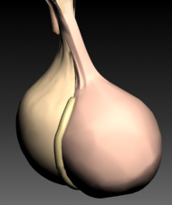
Which regulates
Growth and development of the body
Secretes
Growth hormone
Pituitary gland

Slide 5
If growth hormone is deficient in childhood, it causes dwarfism
If growth hormone is increased, it causes gigantism

Slide 6



Secretes
Testosterone in males
Development of secondary sexual characters like beard, heavy voice
Testis
Due to secretion of testosterone boy
attains puberty
Age 1 to 10
11 and above

Slide 7
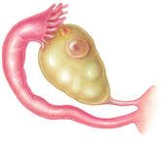


Secretes
Oestrogen in females
Ovary
Development of secondary sexual characters.
Due to secretion of Oestrogen girl
attains puberty
Age 1 to 10
11 and above

Slide 8
Thank You

